Slide 1


2017-2018 Budget
Consideration to Adopt the Final Budget
June 14th, 2017
Notes:
Introduction:
Thanks to the Board and administrative team for the many-many hours spent working on this budget and the effort that went into this budget. Remember we started the budget process with a 50 mill deficit,

Slide 2
Budget Components
Revenue Review
Expenditure Review
Millage Impact
Summary
Notes:
Tonight we will take a look at the major issues impacting the 2004-05 General Fund budget and review major changes to revenues and expenditures.

Slide 3
Revenues

Slide 4
Act 1 Property Tax Relief in CBSD

Slide 5
R.E. Tax Revenue for CBSD

Slide 6
Local Sources of Revenue for CBSD

Slide 7
State Sources of Revenue for CBSD

Slide 8
Federal Sources of Revenue for CBSD

Slide 9
Expenses

Slide 10
Budgeted to Projected Actuals

Slide 11
Projected Staffing for 2017-18 Edited

Slide 12
Millage Impact

Slide 13
Millage Calculation
The Act 1 Real Estate Tax Increase Limit = Base Inflation Index of 2.5% + 1.0% Retirement Exception = 3.5% or 4.3 Mills
The 2017-18 Proposed Millage Rate is 124.1 mills + 0.0 Mills = 124.1 Mills = 0% Increase
For the Typical Homeowner Assessed @ 40,000
  Assessment x 124.1 mills = Gross Tax Bill = $4,964.00
  Less gambling relief (2016-17 tax relief is $199.80) = -201.54
  Tax bill with tax relief $4,762.46
  Real estate tax cut compared to current year = $1.74
Notes:
Explain chart
When you get to Act 72 millage limit, remind them that districts in NJ, Oh, and Del stop at that point under referendum because that want to have something banked for lean years.

Slide 14
Act 1 Tax Index + Exceptions

Slide 15
Summary
The Final Budget for 2017-18 is $331,810,756
$13,926,209 Increase over the 2016-17 Projected Actual Expenditures
  Most of the increase, $6.9M, is associated with retirement system funding and Health care Expenses.

Slide 16
Summary continued
Budget initiatives of:
Continue Rollout of iPads, Laptops and expansion of the Wireless Network
Adding 1 Staff Developer for Technology
Improve the Safety and Playability of Athletic Fields
15 Additional Middle School Teachers (new proposed schedule)
7.9 Additional Special Education Teachers
Add 9th Grade Sports for Basketball, Soccer, Softball/Baseball
Expand Middle School Clubs

Slide 17
Next Steps for June 14th . . . .
Board of School Directors
  Consideration to adopt the 2017-18 Final Budget in the amount of $331,810,756
  Consideration to adopt the resolution for the 2017-18 Homestead and Farmstead real estate tax relief of $201.54
  Consideration to adopt the taxing resolution for real estate, earned income, and electric utilities

Slide 18
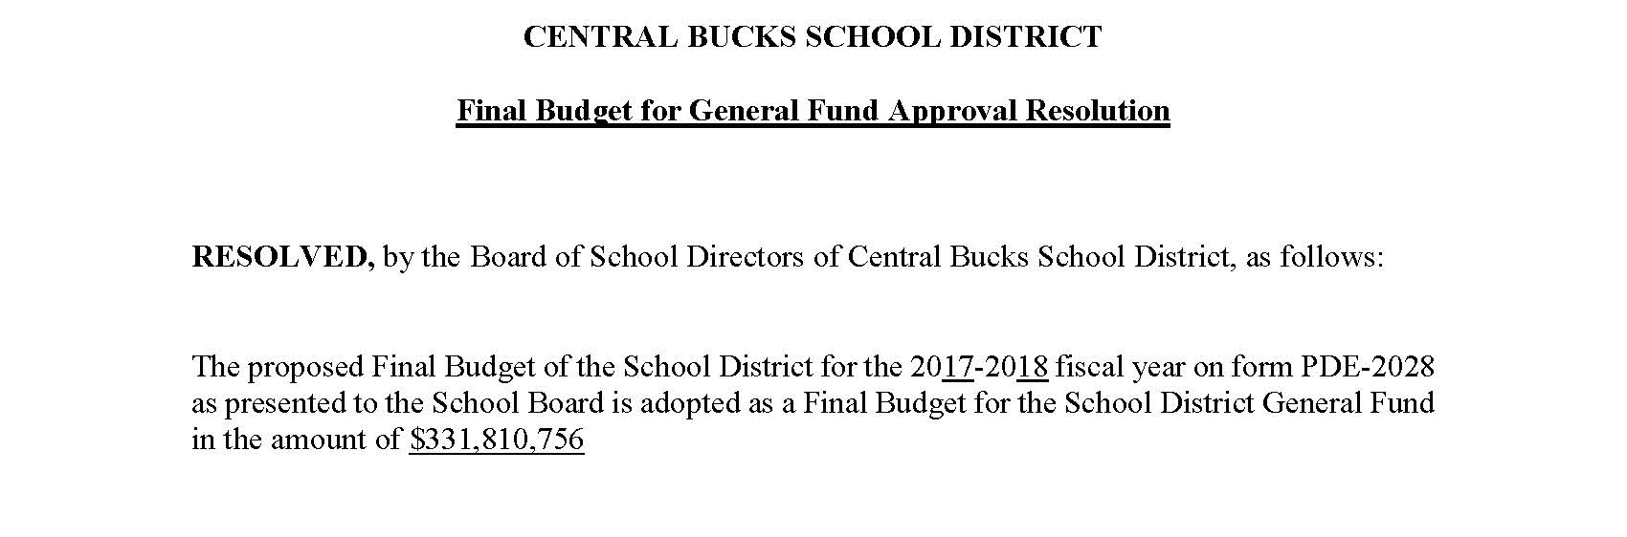

Slide 19
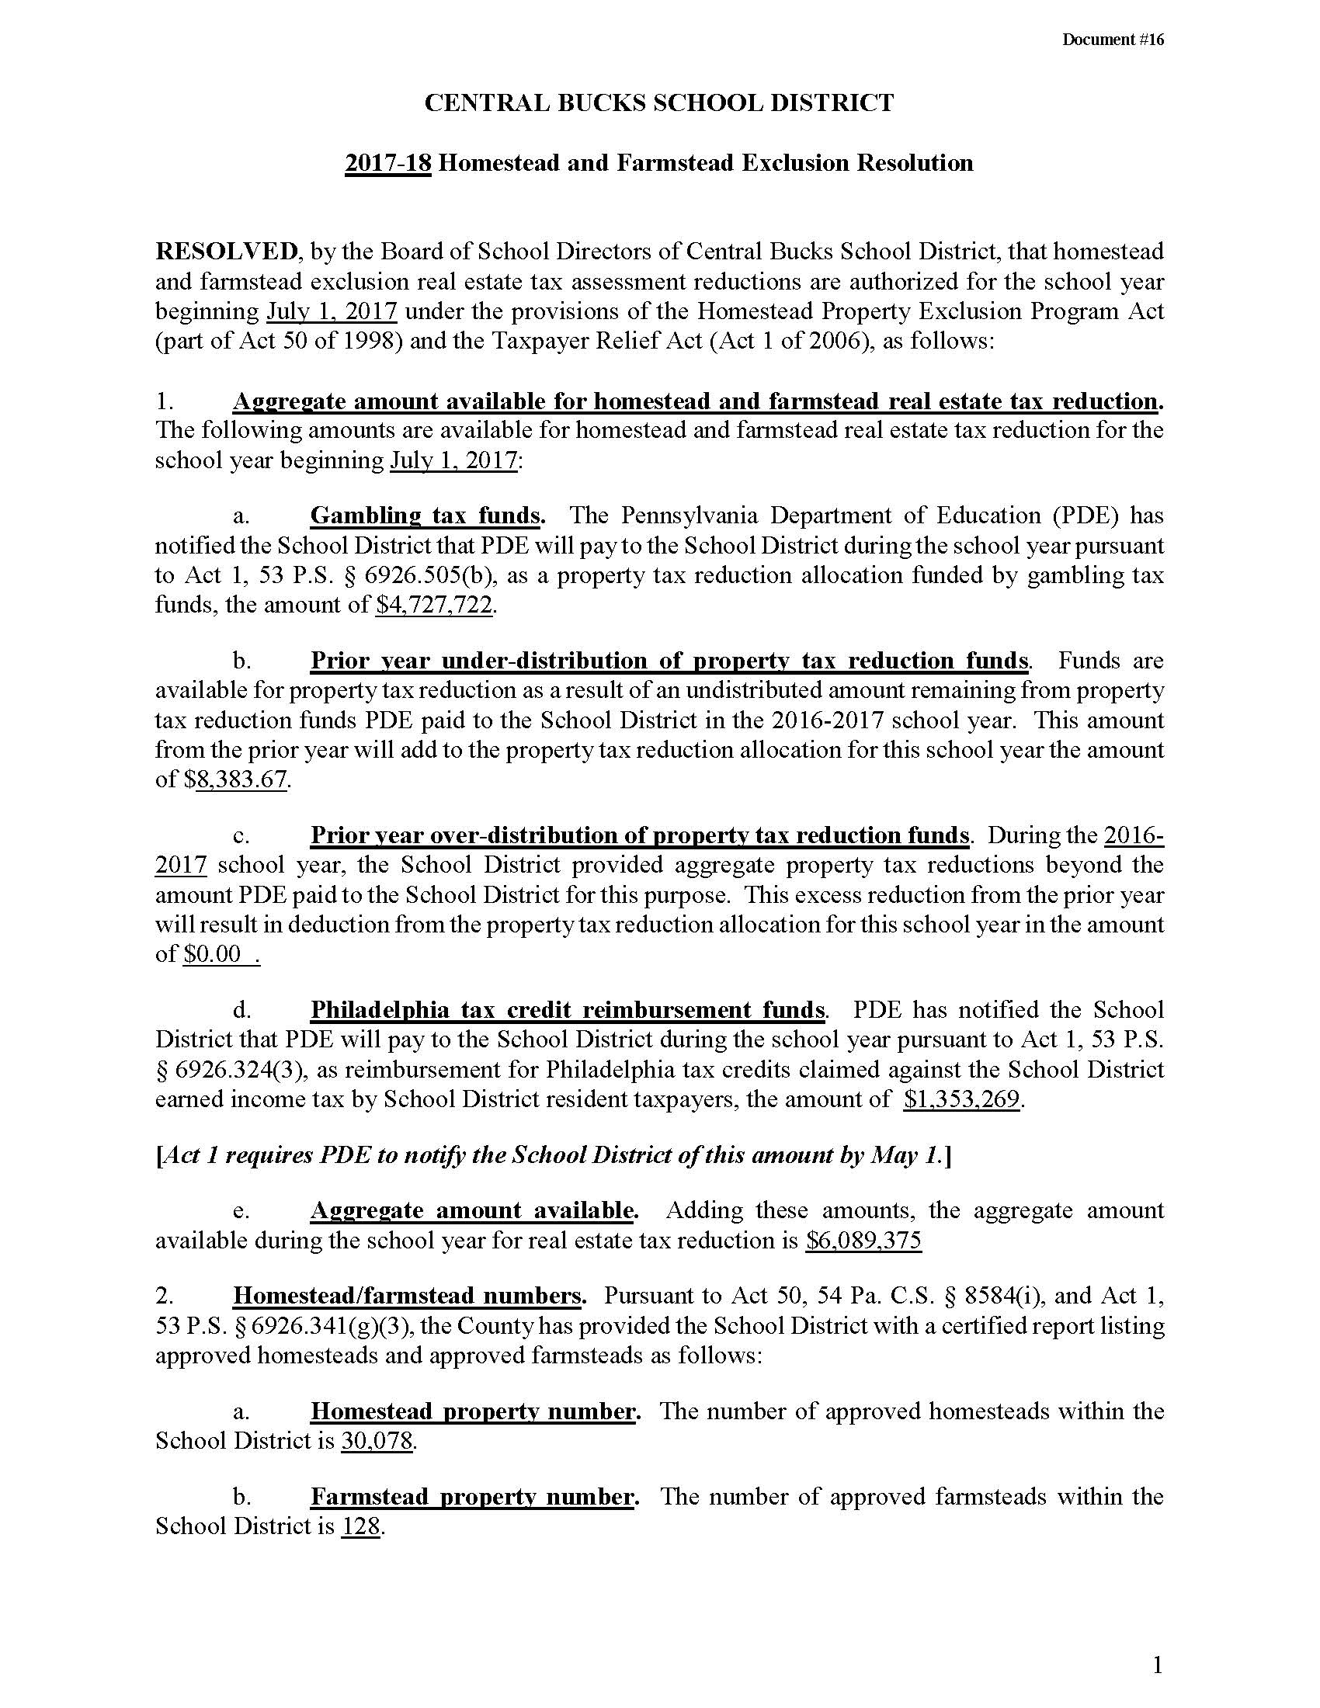

Slide 20
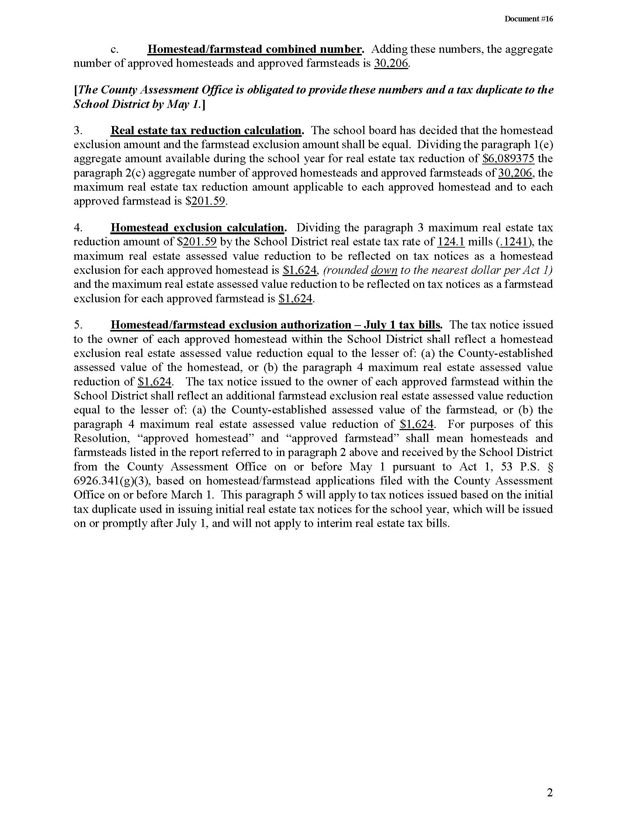

Slide 21
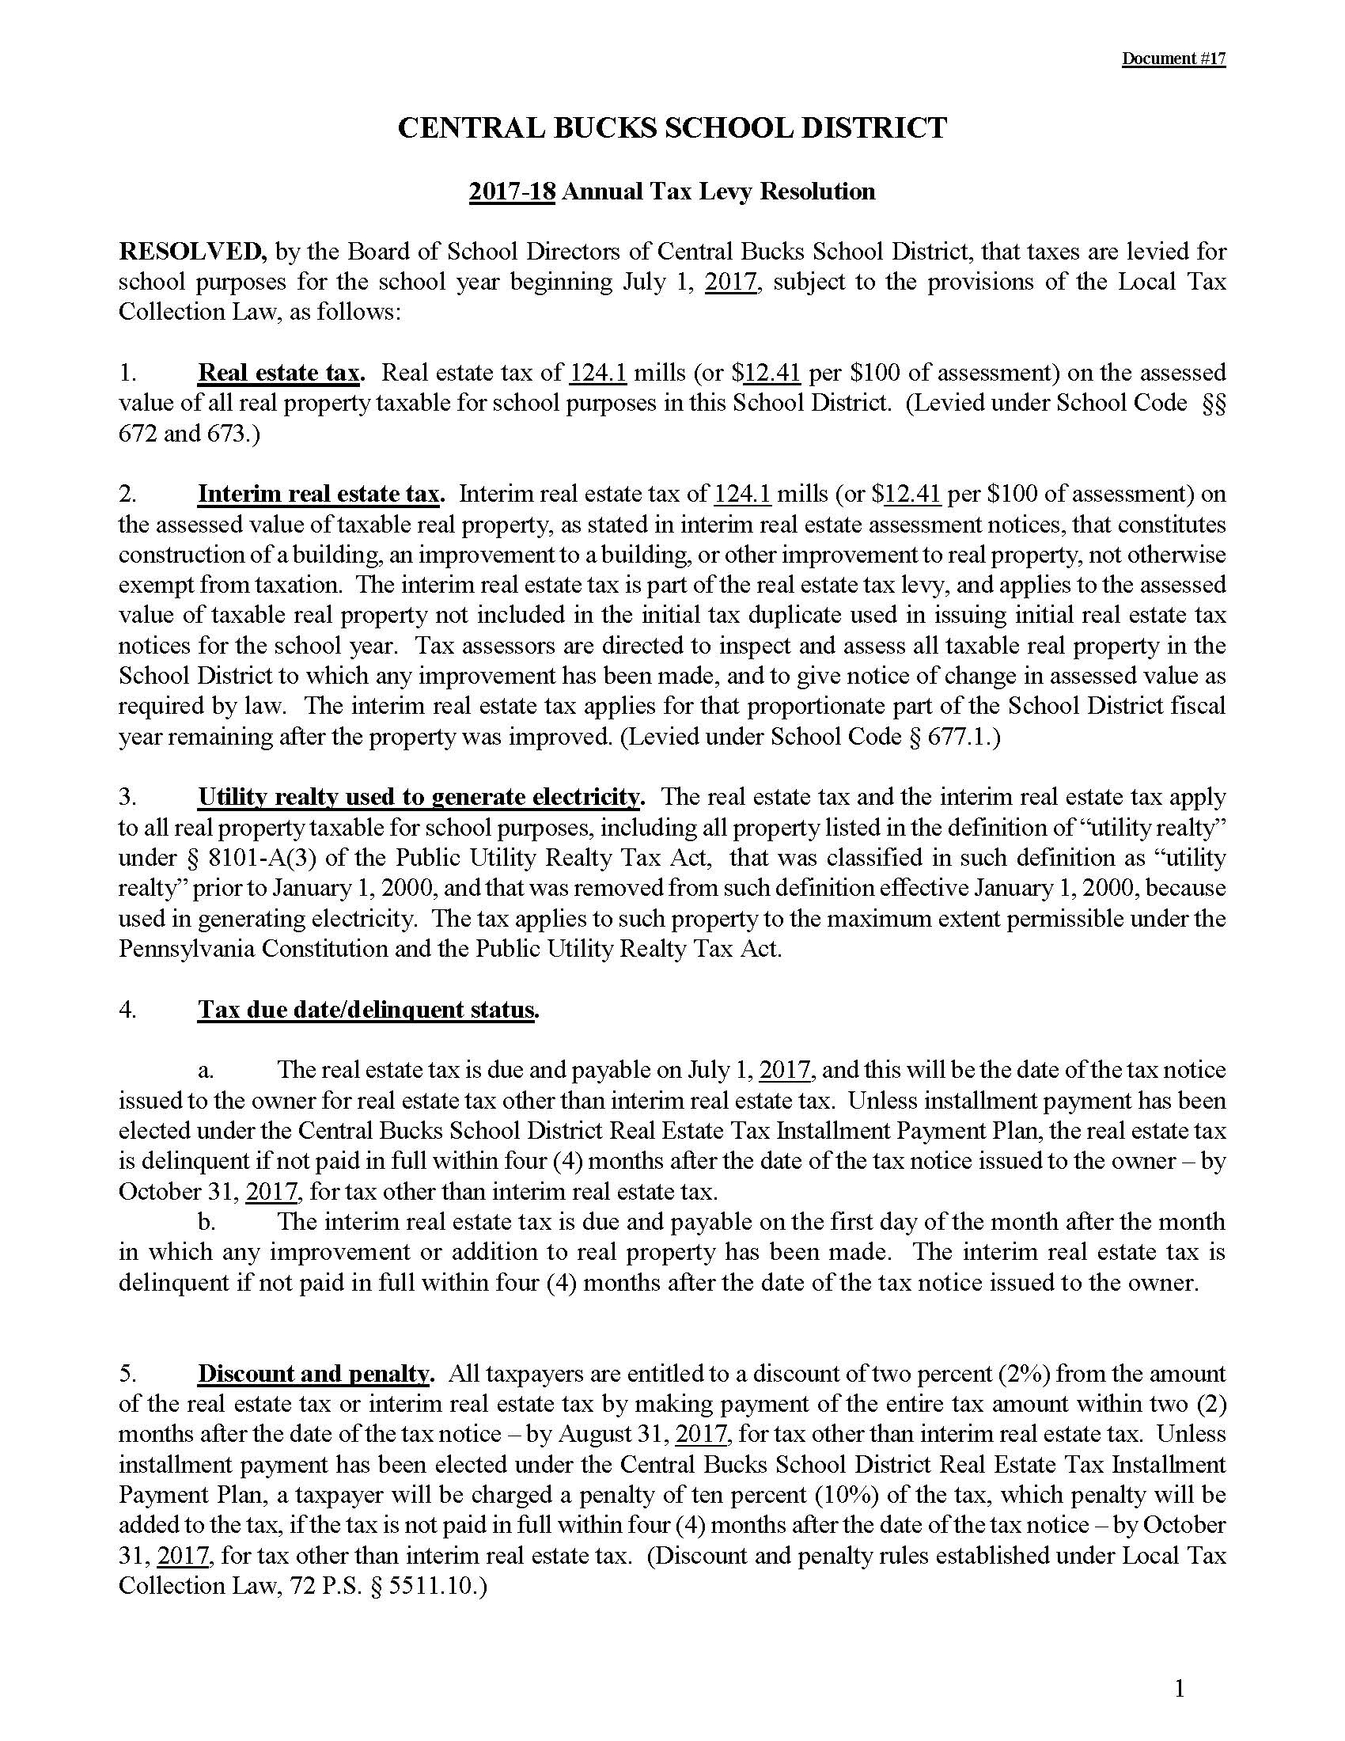

Slide 22
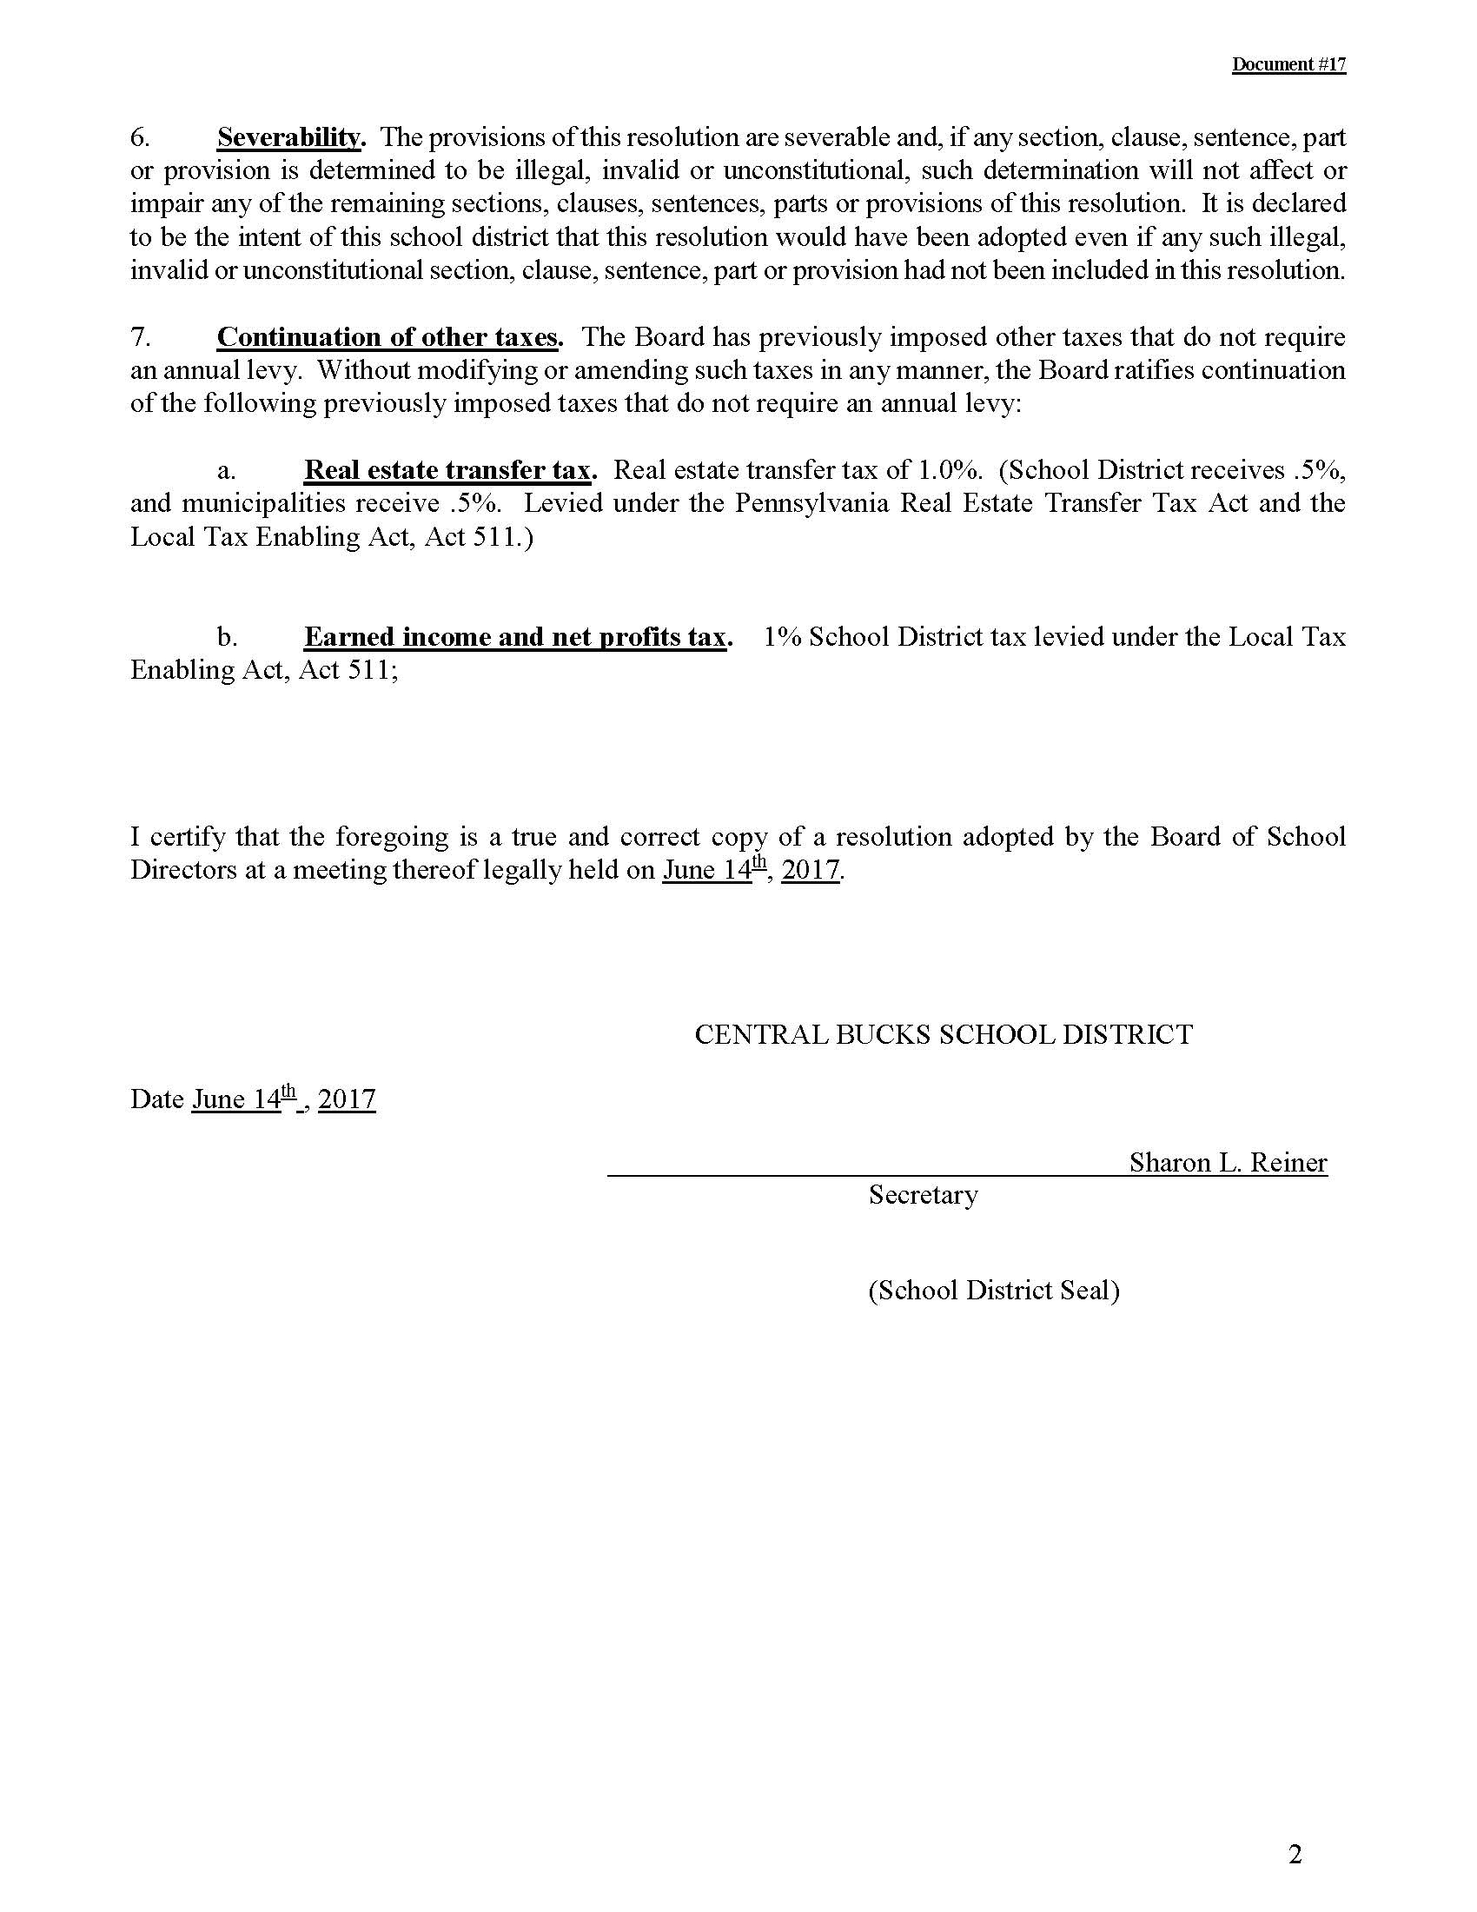

Slide 23
CB

